Slide 1
OS’24 Project
Milestone 1: PREPROCESSING
TESTING LOCKS

Slide 2

New Files
SELECT ALL in the given “FILES_TO_BE_COPIED” folder,
COPY & PASTE (REPLACE ALL) in FOS_CODES/FOS_PROJECT_2024_TEMPLATE/

Slide 3
FIRST: Modular Tests
Module | Function | Testing | Files
Sleep Lock | Sleep + Wakeup ALL | FOS> run tst_chan_all 100 Enter the number of Slave Programs: 7 | kern/conc/channel.c
 | Sleep + Wakeup ONE | FOS> run tst_chan_one 100 Enter the number of Slave Programs: 7 | kern/conc/channel.c
 | Acquire + Release | UNSEEN – Test at your own | kern/conc/sleeplock.c
"Congratulations!! test [TEST NAME] completed successfully.”
To ensure the test success, a congratulations message like this MUST appear without any ERROR messages or PANICs.

Slide 4
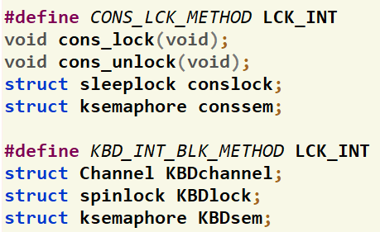
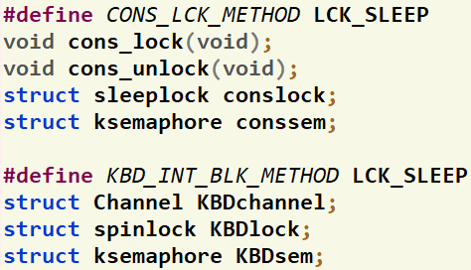
SECOND: Overall Test
Sleeplock & Channel sleep/wakeup are currently used in the FOS to:
Lock the Console:
Allow the user program to print message(s) and receive input in a critical section
So, no other processes can receive inputs or print messages while another process do
Allow Interrupt-based Keyboard Input:
While a process waiting for an input from keyboard, it’s slept (i.e. blocked) until the input is received
Upon receiving a char, an interrupt is issued to allow the process to get this char
To test the correct functionality of sleeplock & channel sleep/wakeup for the above two points:
Change the method of handling both points from INTERRUPT-based into SLEEP-based, as follows
(kern/cons/console.h)

Slide 5
SECOND: Overall Test
Run the following THREE programs
FOS> load mergesort //apply mergesort on array of size 800,000
FOS> load fib //calculate the Fibonacci at the given index
FOS> load fib //calculate the Fibonacci at the given index
FOS> runall //run all processes
During the run, do the following:
When prompting for the Fibonacci index of the FIRST fib program: write 35 and press Enter
When prompting for the Fibonacci index of the SECOND fib program: write 38, WAIT for ~15sec
Upon pressing Enter, BOTH mergesort and first fib are finished IMMEDIATELY without any delay since both are actually running during the previous 30sec waiting period
After ~20sec, the second fib will be finished
Repeat steps 2 & 3 but without the changes in step1 (i.e. using LCK_INT instead of LCK_SLEEP): at step 3.c), note all programs will be running for a noticeable period of time before any of them is finished
35
Press Enter
38
WAIT for ~15sec

Slide 6
Thank you for your care…
Enjoy making your own FOS ☺

